Slide 2
What is Hive
Hive is a data warehouse infrastructure tool to process structured data in Hadoop.
It resides on top of Hadoop to summarize Big Data, and makes querying and analyzing easy.
Initially Hive was developed by Facebook, later the Apache Software Foundation took it up and developed it further as an open source under the name Apache Hive.
It is used by different companies. For example, Amazon uses it in Amazon Elastic MapReduce.
Hive is not
A relational database
A design for OnLine Transaction Processing (OLTP)
A language for real-time queries and row-level updates

Slide 3
Features of Hive
It stores schema in a database and processed data into HDFS.
It is designed for OLAP.
It provides SQL type language for querying called HiveQL or HQL.
It is familiar, fast, scalable, and extensible.

Slide 4
Hive - Data Types
Column Types
Literals
Null Values
Complex Types

Slide 5
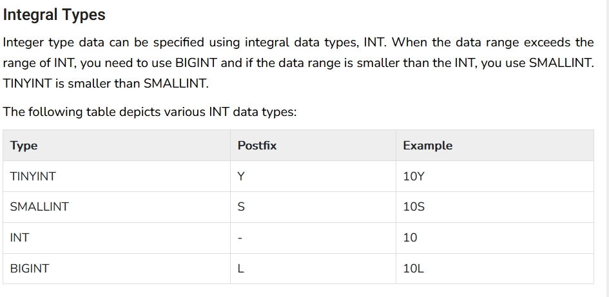
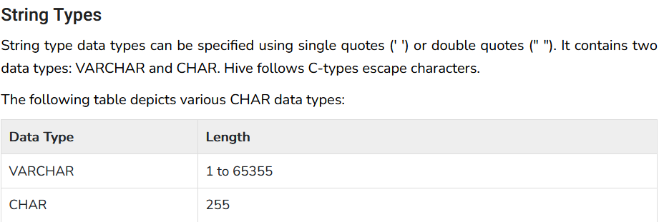
Colum type

Slide 6
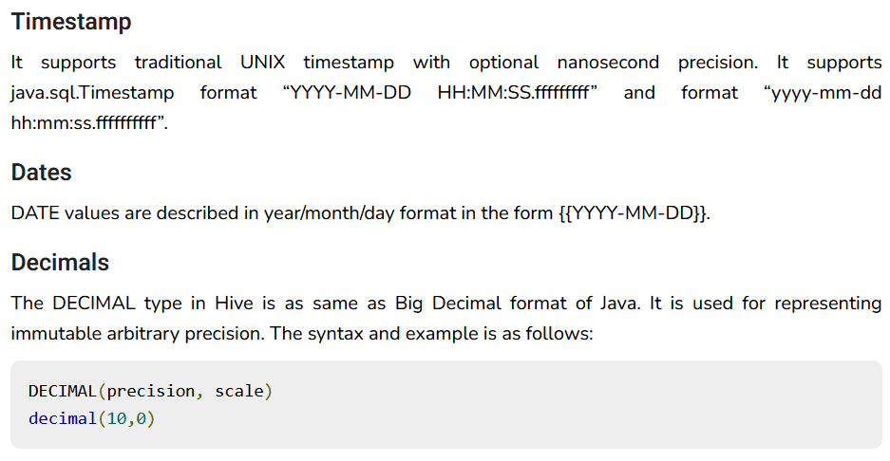

Slide 7
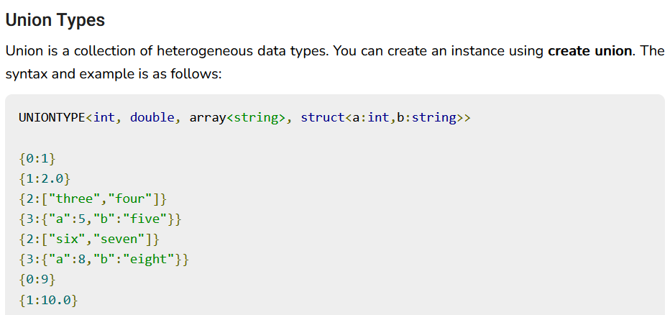

Slide 8
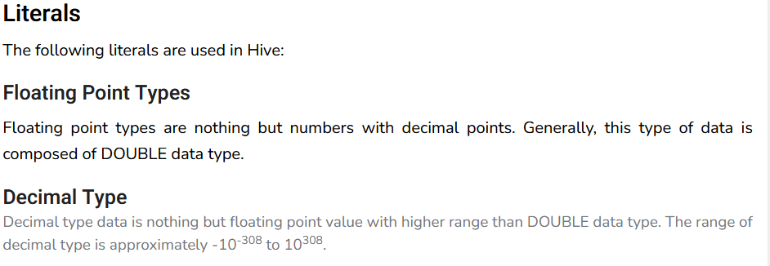

literals

Slide 9
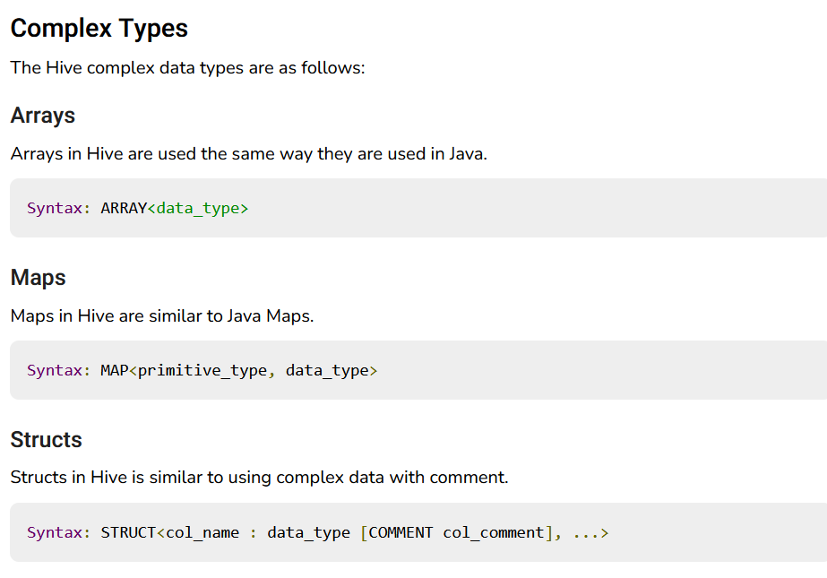

Slide 10
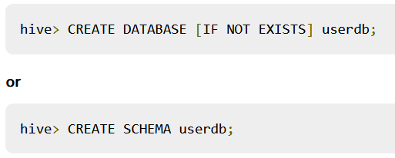

Create Database Statement
A database in Hive is a namespace or a collection of tables. The syntax for this statement is as follows:

Slide 11

Drop Database Statement

Slide 12
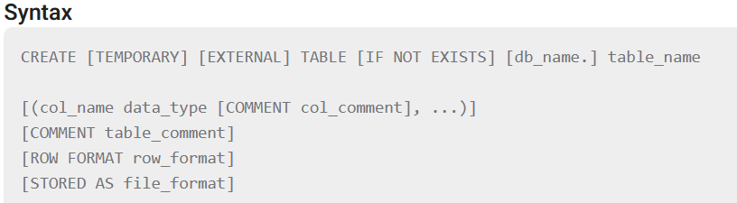
Create table

Slide 13
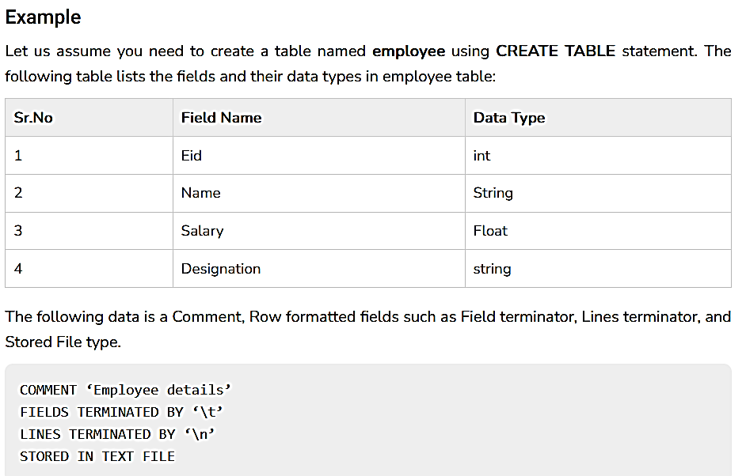

Slide 14
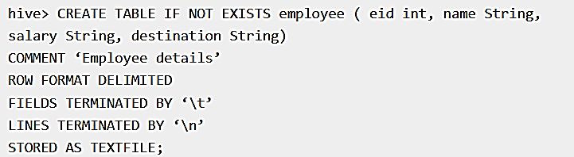

Slide 15
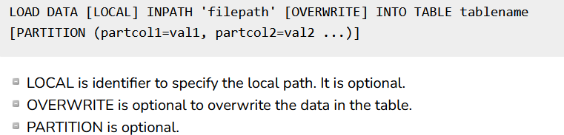
Load Data Statement
insert data using the LOAD DATA statement.

Slide 16
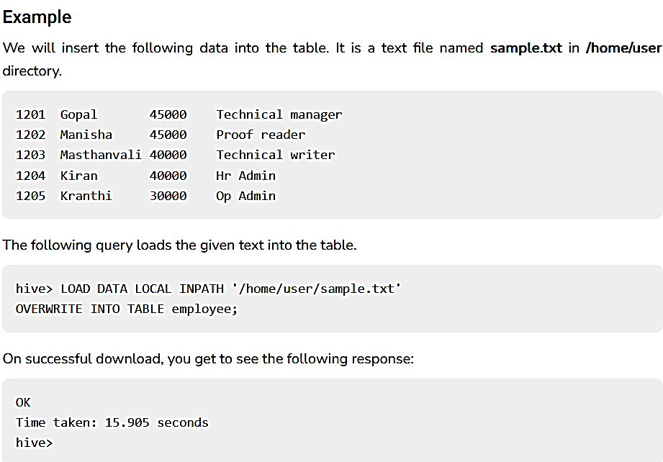

Slide 17
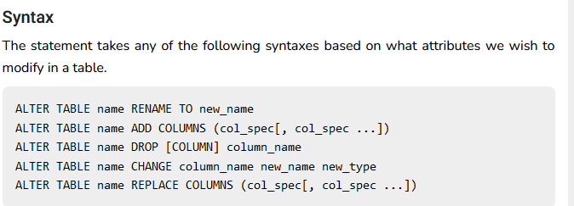
Alter Table Statement

Slide 18
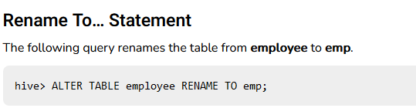

Slide 19
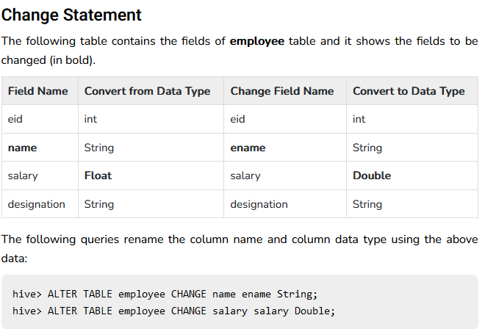

Slide 20
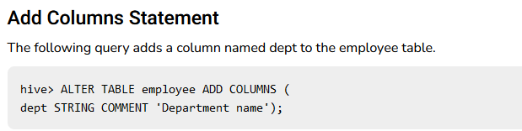

Slide 21
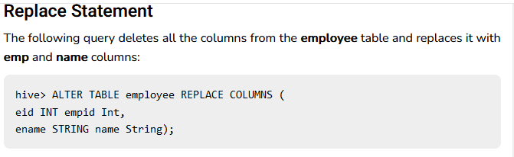

Slide 22
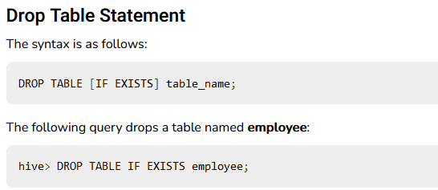

Slide 23
Hive partitioning
Hive organizes tables into partitions.
It is a way of dividing a table into related parts based on the values of partitioned columns such as date, city, and department.
Using partition, it is easy to query a portion of the data.
Tables or partitions are sub-divided into buckets, to provide extra structure to the data that may be used for more efficient querying.
Bucketing works based on the value of hash function of some column of a table.

Slide 24
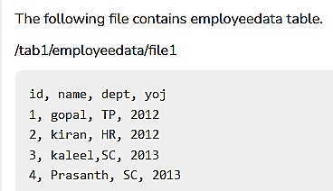
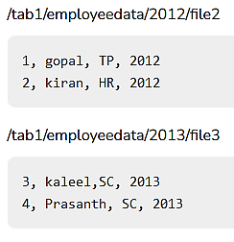

Slide 25
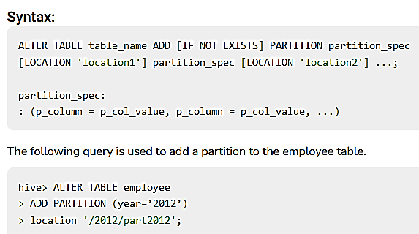
Adding a partition

Slide 26
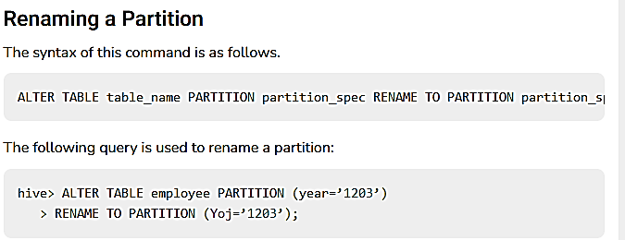

Slide 27
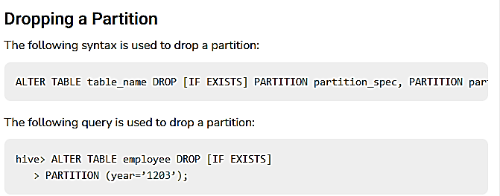

Slide 28
Hive - Built-in Operators
Relational Operators
Arithmetic Operators
Logical Operators
Complex Operators

Slide 29
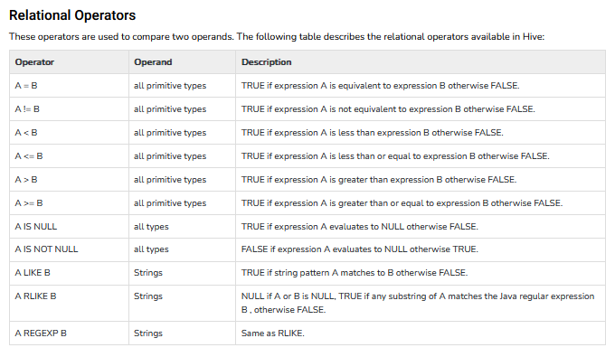

Slide 30
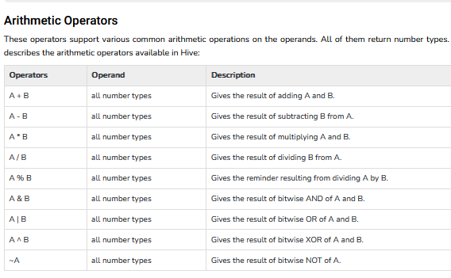

Slide 31
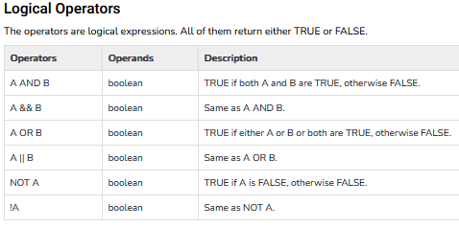

Slide 32
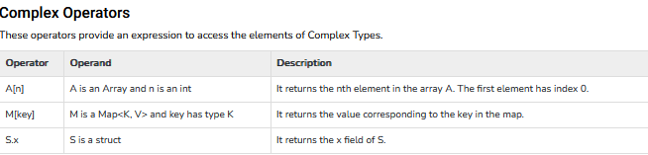

Slide 33
Hive - Built-in Functions

Slide 34
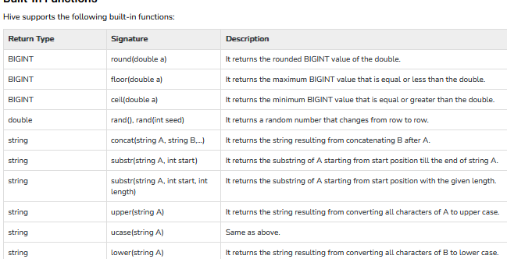

Slide 35
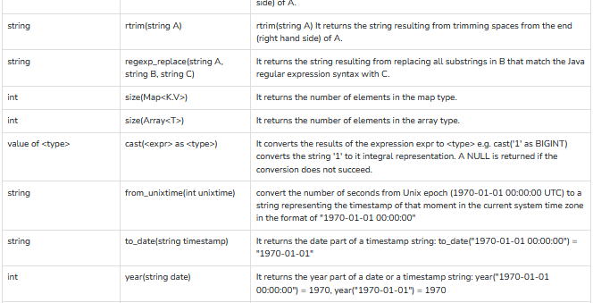

Slide 36
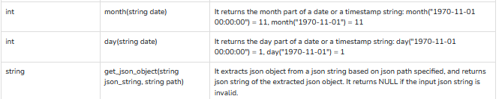

Slide 37
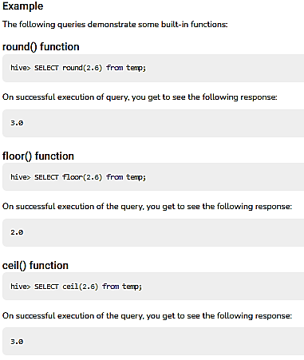

Slide 38
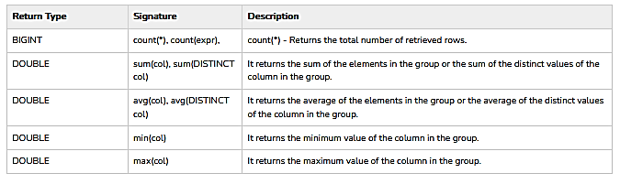
Aggregate functions

Slide 39
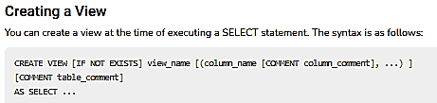
Hive - View and Indexes

Slide 40
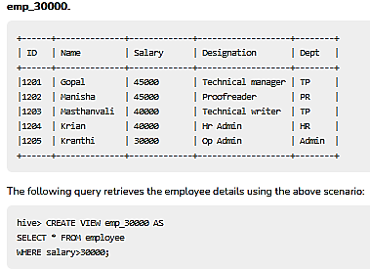

Slide 41
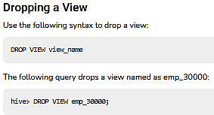

Slide 42
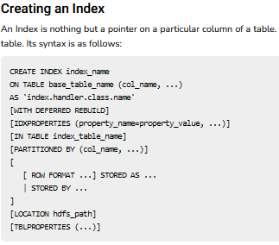

Slide 43


Slide 44
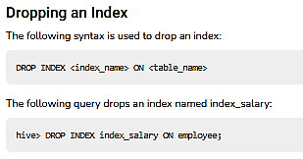

Slide 45
where
Generate a query to retrieve the employee details who earn a salary of more than Rs 30000.

Slide 46

Order by
The ORDER BY clause is used to retrieve the details based on one column and sort the result set by ascending or descending order.

Slide 47
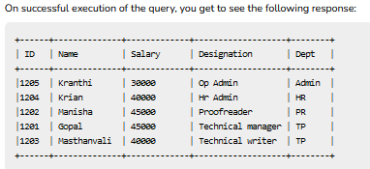

Slide 48
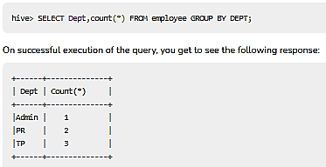
Group By
The GROUP BY clause is used to group all the records in a result set using a particular collection column. It is used to query a group of records.

Slide 49
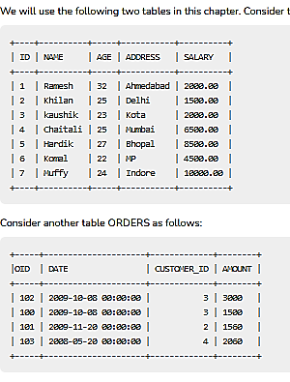
Joins
There are different types of joins given as follows:
JOIN
LEFT OUTER JOIN
RIGHT OUTER JOIN
FULL OUTER JOIN

